Slide 1
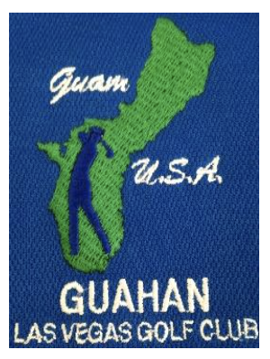
Hafa Adai Golf Classic
Welcome Golfers, Families, and Guests
Hosted by the Chamorro Golf Club Washington State

